Slide 1
Workplace and Diversity
Diversity Plan

Slide 2


Goals of the Diversity Plan
The plan aims at addressing the needs of different stakeholders from the employees to the suppliers.
The plan further aims to address diverse cultural needs of organization arising from globalization that may inhibit its success.

Slide 3


Recommendations
Communication of the diversity plans will play a critical role in addressing diversity issues.
Inclusive leadership in a globalized setting is expected to streamline business operations.

Slide 4
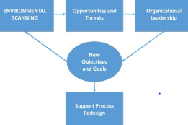
Implementation Challenges and Solution
Environmental scanning as illustrated below will aid in addressing attitudinal barriers.
Proper visual communications will address language barriers.

Slide 5


Strength of the Plan
The plan addresses issues from all perspective the leaders and employees through strategies such as open door policy and inclusive leadership.
On that note, the plan fosters team work amongst organizational staff.

